Slide 1
Data Structures and Algorithms
QUEUES

Slide 2
Queues
A Queue is a special kind of list, where items are inserted at one end (the rear) And deleted at the other end (the front).
Accessing the elements of queues follows a First In,First Out (FIFO) order.
Example
  Like customers standing in a check-out line in a store, the first customer in is the first customer served.

Slide 3
Common Operations on Queues
MAKENULL:
FRONT(Q): Returns the first element on Queue Q.
ENQUEUE(x,Q): Inserts element x at the end of Queue Q.
DEQUEUE(Q): Deletes the first element of Q.
ISEMPTY(Q): Returns true if and only if Q is an empty queue.
ISFULL(Q): Returns true if and only if Q is full.

Slide 4

Enqueue and Dequeue
Primary queue operations: Enqueue and Dequeue
Enqueue – insert an element at the rear of the queue.
Dequeue – remove an element from the front of the queue.

Slide 5
Queues Implementations
Static
  Queue is implemented by an array, and size of queue remains fix
Dynamic
  A queue can be implemented as a linked list, and expand or shrink with each enqueue or dequeue operation.

Slide 6
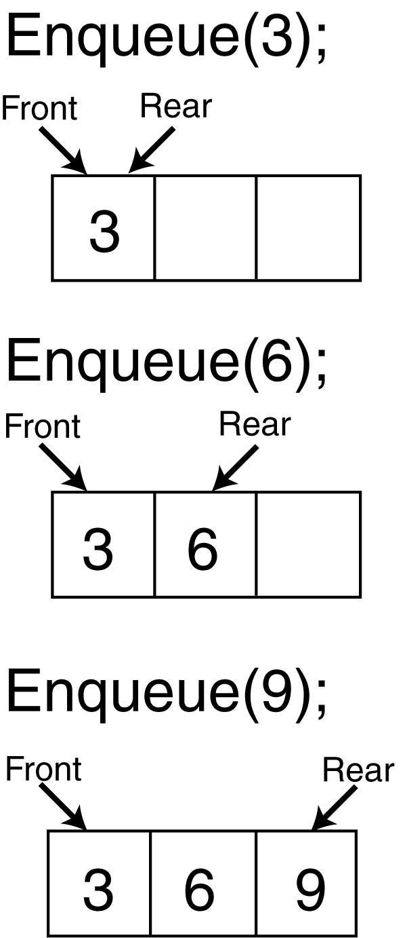
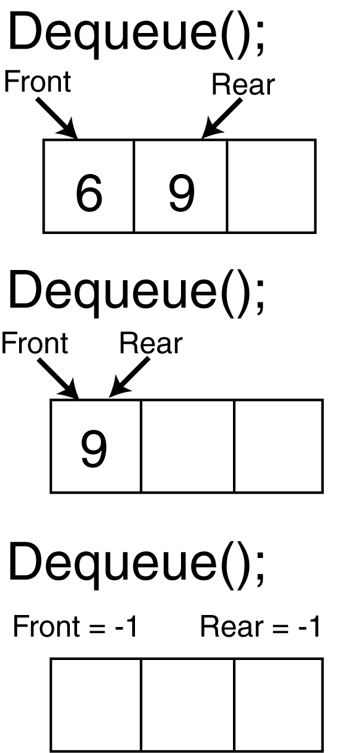
Static Implementation of Queues

Slide 7
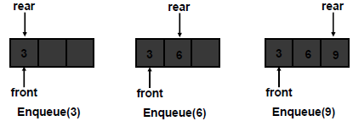
Static Implementation of Queue
Static implementation is done using arrays
In this implementation, we should know the exact number of elements to be stored in the queue.
When enqueuing, the front index is always fixed and the rear index moves forward in the array.

Slide 8
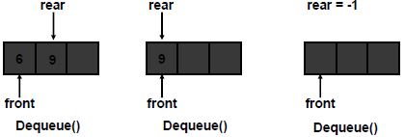
Static Implementation of Queue
When dequeuing, the front index is fixed, and the element at the front of the queue is removed. Move all the elements after it by one position. (Inefficient!!!)

Slide 9
Static Implementation of Queue
A better way
  When an item is enqueued, the rear index moves forward.
  When an item is dequeued, the front index also moves forward by one element
Example:
X = occupied, and O = empty
(front) XXXXOOOOO (rear)
OXXXXOOOO (after 1 dequeue, and 1 enqueue)
OOXXXXXOO (after another dequeue, and 2 enqueues)
OOOOXXXXX (after 2 more dequeues, and 2 enqueues)
The problem here is that the rear index cannot move beyond the last element in the array.

Slide 10
Static Implementation of Queue
To overcome the above limitation, we can use circular array implementation of queues.
In this implementation, first position follows the last.
When an element moves past the end of a circular array, it wraps around to the beginning, e.g
  OOOOO7963 ->4OOOO7963 (after Enqueue(4))
  After Enqueue(4), the rear index moves from 3 to 4.
How to detect an empty or full queue, using a circular array algorithm?
  Use a counter of the number of elements in the queue.

Slide 11
Circular Queue
Q.rear
Q.rear
Q.front
Q.rear
Q.front
i
i
h
a
g
b
f
c
e
d
A Completely
Filled Queue
A Queue with
Only 1 Element

Slide 12
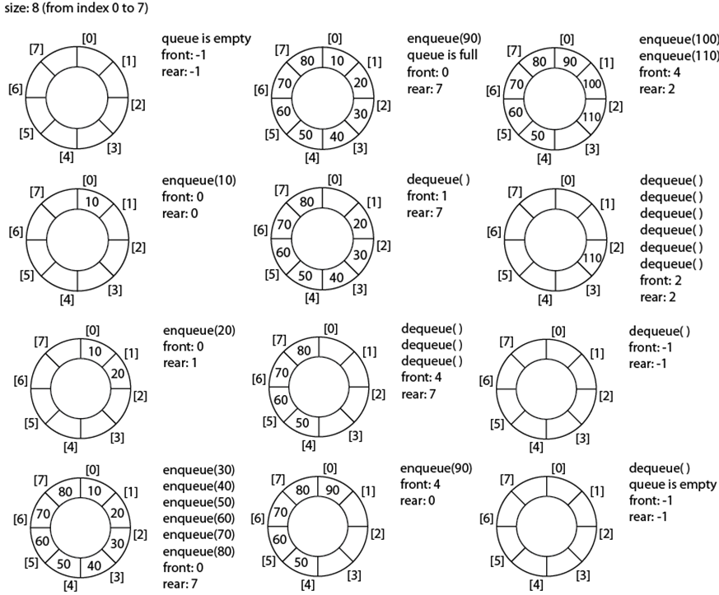

Slide 13
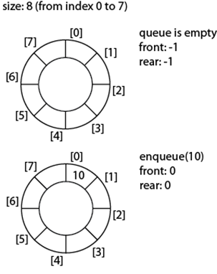
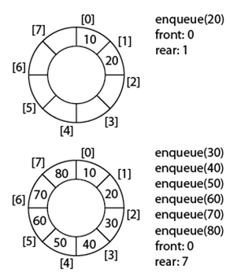

Slide 14
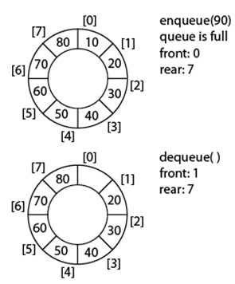
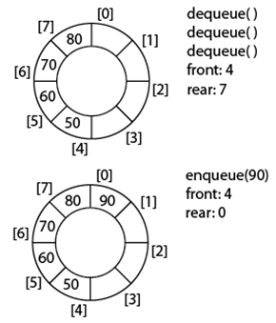

Slide 15
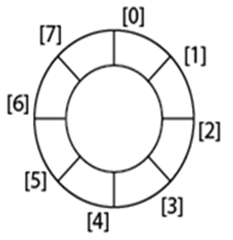


Slide 16
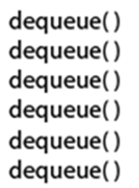

Slide 17
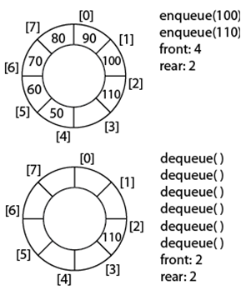
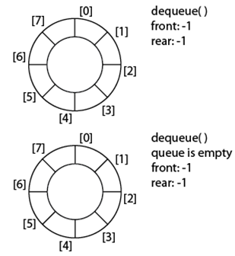

Slide 18
ALGORITHM FOR QUEUE OPERATIONS
Let Q be the array of some specified size say SIZE
INSERTING AN ELEMENT INTO THE QUEUE
1. Initialize front=0 rear = –1
2. Input the value to be inserted and assign to variable “data”
3. If (rear >= SIZE)
(a) Display “Queue overflow”
(b) Exit
4. Else
(a) Rear = rear +1
5. Q[rear] = data
6. Exit

Slide 19
ALGORITHM FOR QUEUE OPERATIONS
DELETING AN ELEMENT FROM QUEUE
1. If (rear< front)
(a) Front = 0, rear = –1
(b) Display “The queue is empty”
(c) Exit
2. Else
(a) Data = Q[front]
3. Front = front +1
4. Exit

Slide 20
OTHER QUEUES
There are three major variations in a simple queue. They are
1. Circular queue
2. Double ended queue (de-queue)
3. Priority queue

Slide 21
CIRCULAR QUEUES
-In circular queues the elements Q[0],Q[1],Q[2] .... Q[n – 1] is represented in a circular fashion with Q[1] following Q[n].
one in which the insertion of a new element is done at the very first location of the queue if the last location at the queue is full

Slide 22
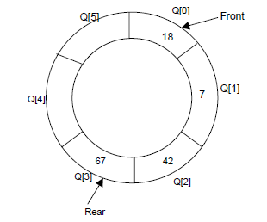
CIRCULAR QUEUES
After inserting 18, 7, 42, 67

Slide 23
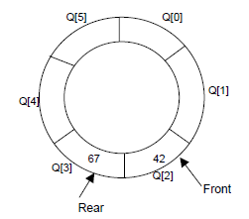
CIRCULAR QUEUES
After popping 18, 7

Slide 24
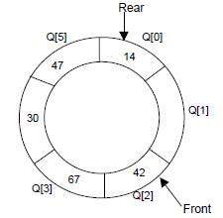
CIRCULAR QUEUES
After pushing 30,47,14

Slide 25
ALGORITHM OF CIRCULAR QUEUES
Let Q be the array of some specified size say SIZE. FRONT and REAR are two pointers where the elements are deleted and inserted at two ends of the circular queue. DATA is the element to be inserted.

Slide 26
ALGORITHM OF CIRCULAR QUEUES
Inserting an element to circular Queue
1. Initialize FRONT = – 1; REAR = 1
2. REAR = (REAR + 1) % SIZE
3. If (FRONT is equal to REAR)
(a) Display “Queue is full” (b) Exit
4. Else
(a) Input the value to be inserted and assign to variable “DATA”
5. If (FRONT is equal to – 1)
(a) FRONT = 0 (b) REAR = 0
6. Q[REAR] = DATA
7. Repeat steps 2 to 5 if we want to insert more elements
8. Exit

Slide 27
ALGORITHM OF CIRCULAR QUEUES
Deleting an element from a circular queue
1. If (FRONT is equal to – 1)
(a) Display “Queue is empty”
(b) Exit
2. Else
(a) DATA = Q[FRONT]
3. If (REAR is equal to FRONT)
(a) FRONT = –1
(b) REAR = –1
4. Else
(a) FRONT = (FRONT +1) % SIZE
5. Repeat the steps 1, 2 and 3 if we want to delete more elements
6. Exit

Slide 28
Double Ended Queue (Deque)
A deque is a linear list in which all insertions and deletions are made at the end of the list.
A deque is pronounced as ‘deck’ or ‘de queue’.
It is a sort of FLIFLO (First In Last In or First Out Last Out).
Refers to the right end or left end of a queue.

Slide 29
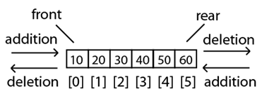
Deque (cont.)
A deque is commonly implemented as a circular array with two variables left and right taking care of the active endsof the deque.

Slide 30
Two Variants of Deque
Input restricted deque
  Insertions are allowed at one end only while deletions are allowed at both ends.
Output restricted deque
  Allows insertions at both ends of the deque but permits deletions only at one end.

Slide 31
ALGORITHMS FOR INSERTING AN ELEMENT
INSERT AN ELEMENT AT THE RIGHT SIDE OF THE DE-QUEUE
1. Input the DATA to be inserted
2. If ((left == 0 && right == MAX–1) || (left == right + 1))
(a) Display “Queue Overflow” (b) Exit
3. If (left == –1)
(a) left = 0 (b) right = 0
4. Else
(a) if (right == MAX –1)
(i) left = 0
(b) else
(i) right = right+1
5. Q[right] = DATA
6. Exit

Slide 32
ALGORITHMS FOR INSERTING AN ELEMENT
INSERT AN ELEMENT AT THE LEFT SIDE OF THE DE-QUEUE
1. Input the DATA to be inserted
2. If ((left == 0 && right == MAX–1) || (left == right+1))
(a) Display “Queue Overflow” (b) Exit
3. If (left == – 1)
(a) Left = 0 (b) Right = 0
4. Else
(a) if (left == 0)
(i) left = MAX – 1
(b) else
(i) left = left – 1
5. Q[left] = DATA
6. Exit

Slide 33
ALGORITHMS FOR DELETING AN ELEMENT
DELETE AN ELEMENT FROM THE RIGHT SIDE OF THE DE-QUEUE
1. If (left == – 1)
(a) Display “Queue Underflow” (b) Exit
2. DATA = Q [right]
3. If (left == right)
(a) left = – 1 (b) right = – 1
4. Else
(a) if(right == 0)
(i) right = MAX-1
(b) else
(i) right = right-1
5. Exit

Slide 34
ALGORITHMS FOR DELETING AN ELEMENT
DELETE AN ELEMENT FROM THE LEFT SIDE OF THE DE-QUEUE
1. If (left == – 1)
(a) Display “Queue Underflow” (b) Exit
2. DATA = Q [left]
3. If(left == right)
(a) left = – 1 (b) right = – 1
4. Else
(a) if (left == MAX-1)
(i) left = 0
(b) Else
(i) left = left +1
5. Exit

Slide 35
Applications of a Linear Queue
Time-sharing system
A CPU endowed with memory resources

Slide 36
Applications of aQueue
1. Round robin techniques for processor scheduling is implemented using queue.
2. Printer server routines (in drivers) are designed using queues.
3. All types of customer service software (like Railway/Air ticket reservation) are
designed using queue to give proper service to the customers.

Slide 37
Priority Queues
Notes:
Not much technical info today
goals, mechanics, a few technical things

Slide 38
PRIORITY QUEUES
Priority Queue is a queue where each element is assigned a priority. In priority queue, the elements are deleted and processed by following rules.
1. An element of higher priority is processed before any element of lower priority.
2. Two elements with the same priority are processed according to the order in which they were inserted to the queue.

Slide 39
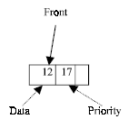
LINKED LIST REPRESENTATION OF PRIORITY QUEUE

Slide 40
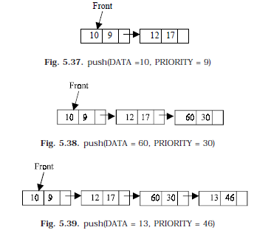

Slide 41
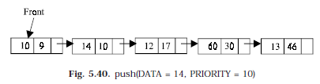
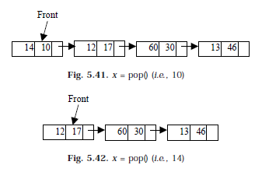

Slide 42
Introduction
Stack and Queue are data structures whose elements are ordered based on a sequence in which they have been inserted
E.g. pop() function removes the item pushed last in the stack
Intrinsic order among the elements themselves (e.g. numeric or alphabetic order etc.) is ignored in a stack or a queue

Slide 43
Definition
A priority queue is a data structure in which prioritized insertion and deletion operations on elements can be performed according to their priority values.
There are two types of priority queues:
  Ascending Priority queue, and a
  Descending Priority queue

Slide 44
Applications commonly require comparing and ranking objects according to parameters or properties, called “keys,” that are assigned to each object in a collection.
key to be an object that is assigned to an element as a
specific attribute for that element and that can be used to identify, rank, or weigh that element.
Example: (comparing)
-companies earning
-restaurant
-priority of standby passengers-

Slide 45
The fundamental functions of a priority queue P are as follows:
insert(e): Insert the element e (with an implicit associated key value)
into P.
min(): Return an element of P with the smallest associated key value, that is, an element whose key is less than or equal to that of every other element in P.
removeMin(): Remove from P the element min().

Slide 46
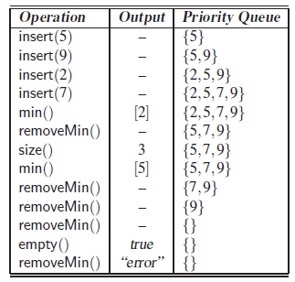

Slide 47
Types of Priority Queue
Ascending Priority queue: a collection of items into which items can be inserted randomly but only the smallest item can be removed
If “A-Priority-Q” is an ascending priority queue then
  Enqueue() will insert item ‘x’ into A-Priority-Q,
  minDequeue() will remove the minimum item from A-Priority-Q and return its value

Slide 48
Types of Priority Queue
Descending Priority queue: a collection of items into which items can be inserted randomly but only the largest item can be removed
If “D-Priority-Q” is a descending priority queue then
  Enqueue() will insert item x into D-Priority-Q,
  maxDequeue( ) will remove the maximum item from D-Priority-Q and return its value

Slide 49
Generally
In both the above types, if elements with equal priority are present, the FIFO technique is applied.
Both types of priority queues are similar in a way that both of them remove and return the element with the highest “Priority” when the function remove() is called.
  For an ascending priority queue item with smallest value has maximum “priority”
  For a descending priority queue item with highest value has maximum “priority”
This implies that we must have criteria for a priority queue to determine the Priority of its constituent elements.
the elements of a priority queue can be numbers, characters or any complex structures such as phone book entries, events in a simulation

Slide 50
Priority Queue Issues
In what manner should the items be inserted in a priority queue
  Ordered (so that retrieval is simple, but insertion will become complex)
  Arbitrary (insertion is simple but retrieval will require elaborate search mechanism)
Retrieval
  In case of un-ordered priority queue, what if minimum number is to be removed from an ascending queue of n elements (n number of comparisons)
In what manner should the queue be maintained when an item is removed from it
  Emptied location is kept blank (how to recognize a blank location ??)
  Remaining items are shifted

